Slide 1

Australian Economy Analysis
Monash FinTech Bootcamp 07/2021
Michelle
michelleqiaox@gmail.com
Scott
core3dsport@gmail.com
Jenny
jenny.tnguyen76@gmail.com
Trib
tthapa3@gmail.com

Slide 2
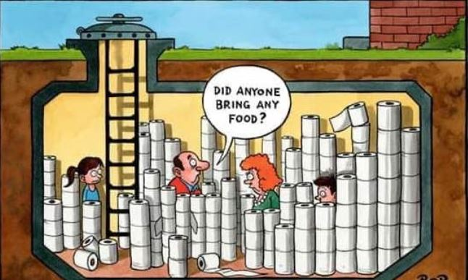

How did we do during the Pandemic…

Slide 3




Summary
Michelle (Strategy Consultant)
Introduction
Scott (Quality Assurance Manager)
Data cleanup and explorations: Foundation of any project
Jenny (Project Engineer)
Graphs and findings: Australia has done well
Trib (Project Manager)
Dashboard and App: Powerful Interactive resource available to anyone

Slide 4
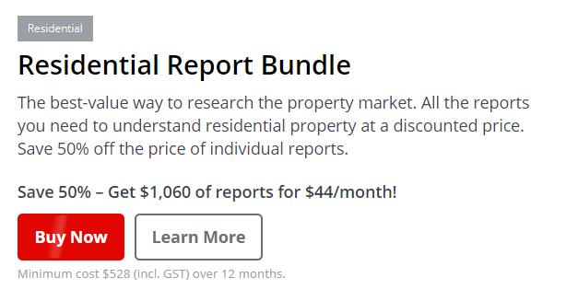
Data Cleanup & Exploration
1. Data Cost
Corelogic
2. Data Reliability
Domain.com
ASX200-Yahoo finance API
3. Australia Bureau of statistics

Slide 5
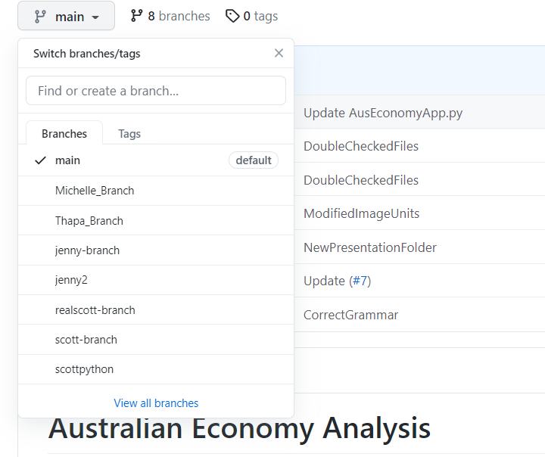
Data Cleanup & Exploration
4. Data Interpretation
Employment- Unit Metrics
Populations-Value Vs. Percentage -Millions Vs. Thousands
5. Data Management
Naming System(Original-Raw-Processed )
Backup Data
GitHub-Merge

Slide 6
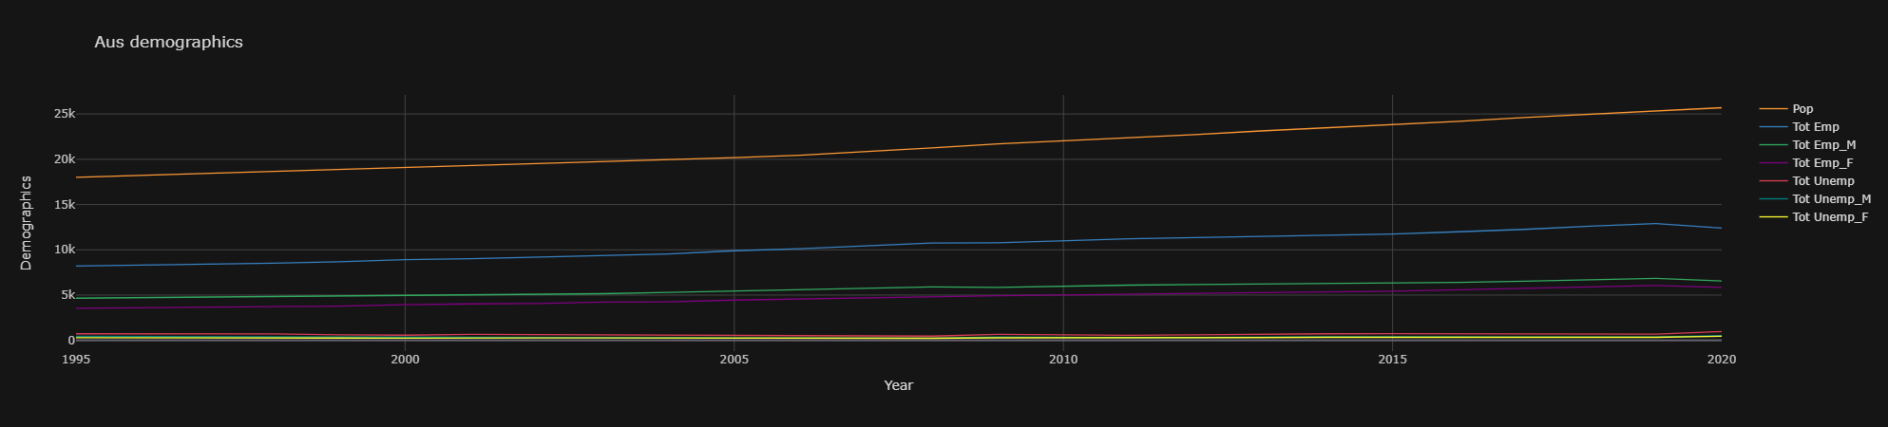
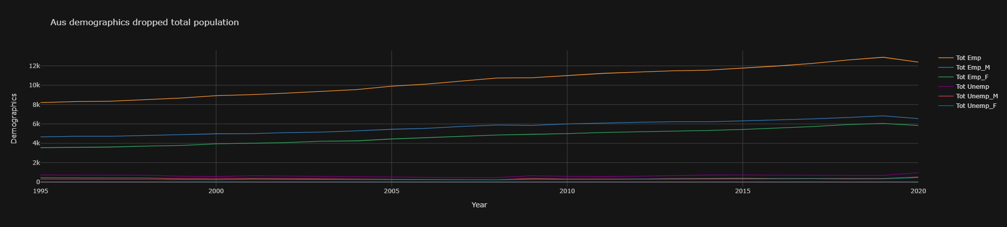
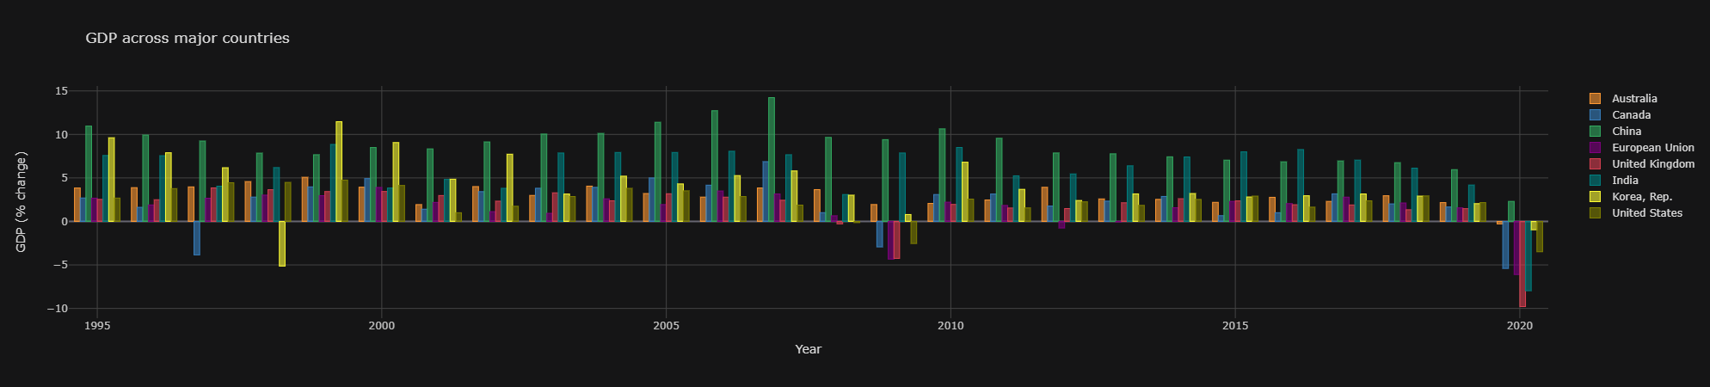
Australia Demographic Data

Slide 7
Australia Demographic Data

Slide 8
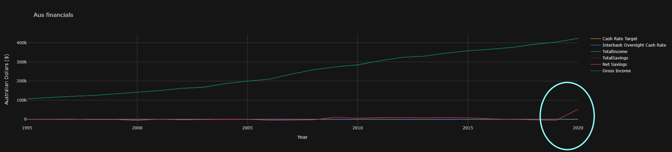
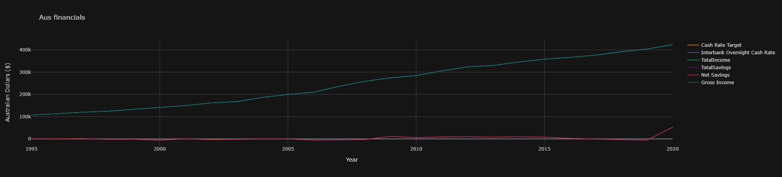
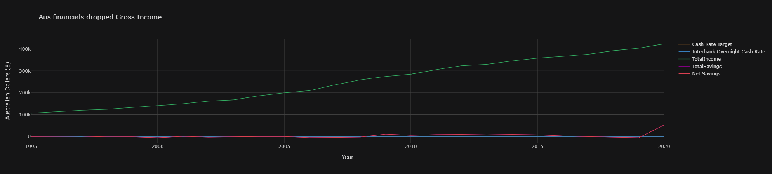
Australia’s Financials

Slide 9
Australia’s Financials

Slide 10
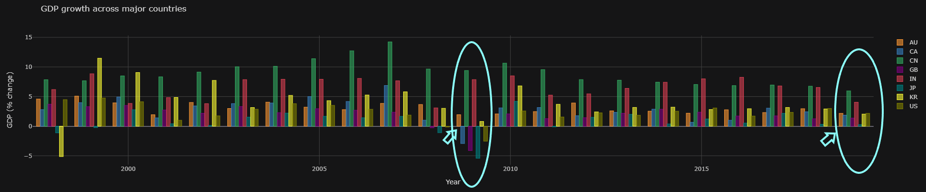
Australia's GDP VS The World

Slide 11
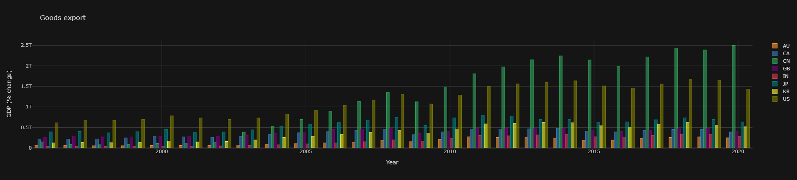
Goods Export

Slide 12
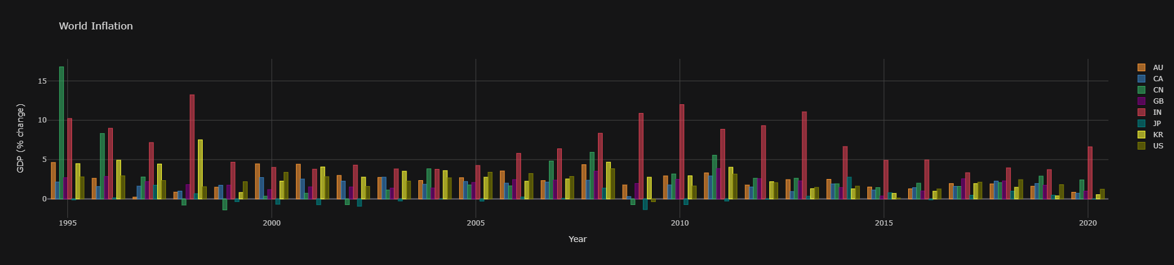
World Inflation

Slide 13
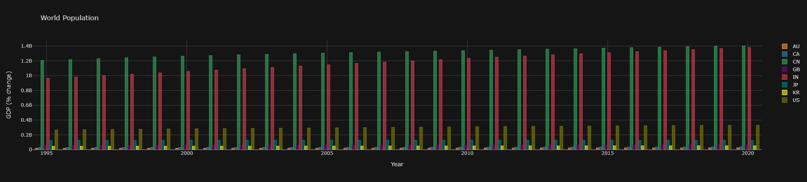
World Population

Slide 14
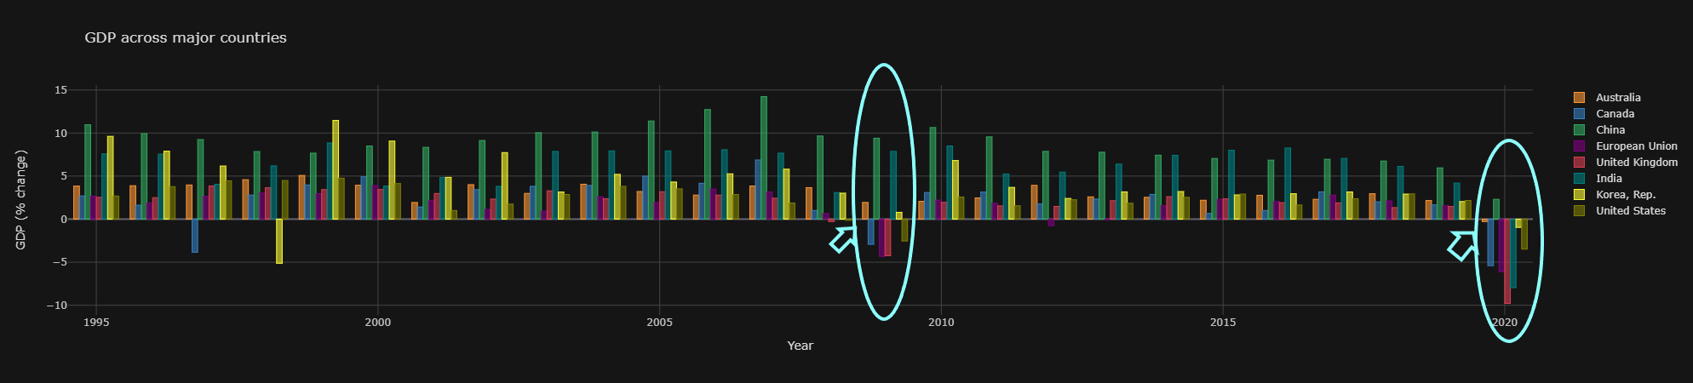
Australia VS The World 's GDP

Slide 15
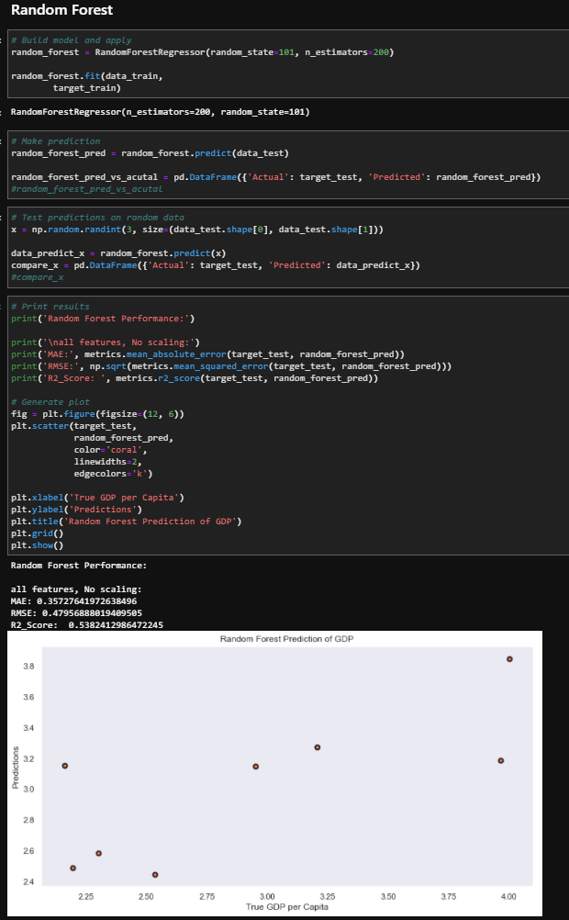
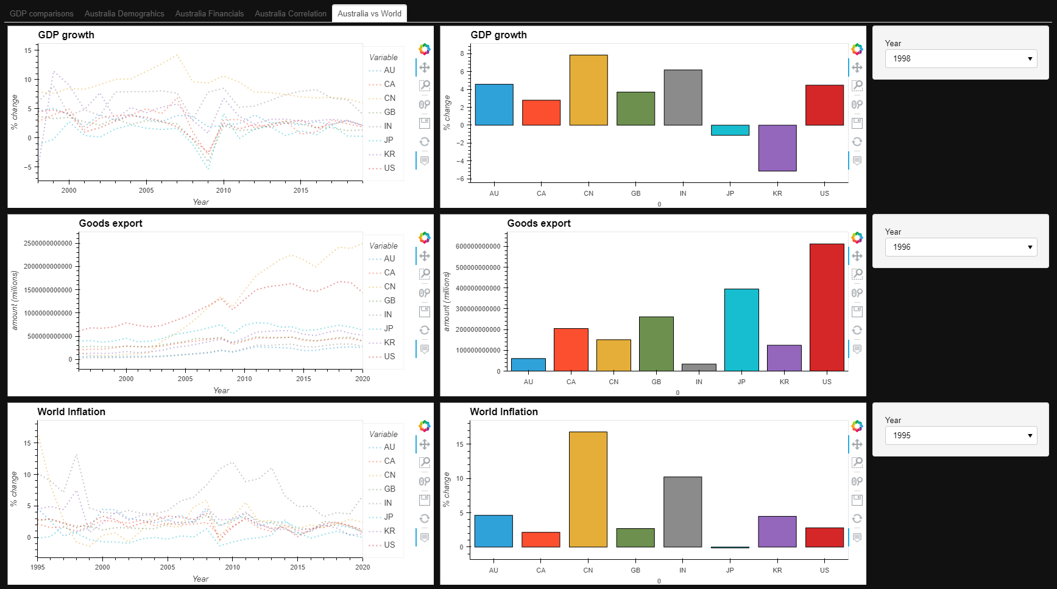
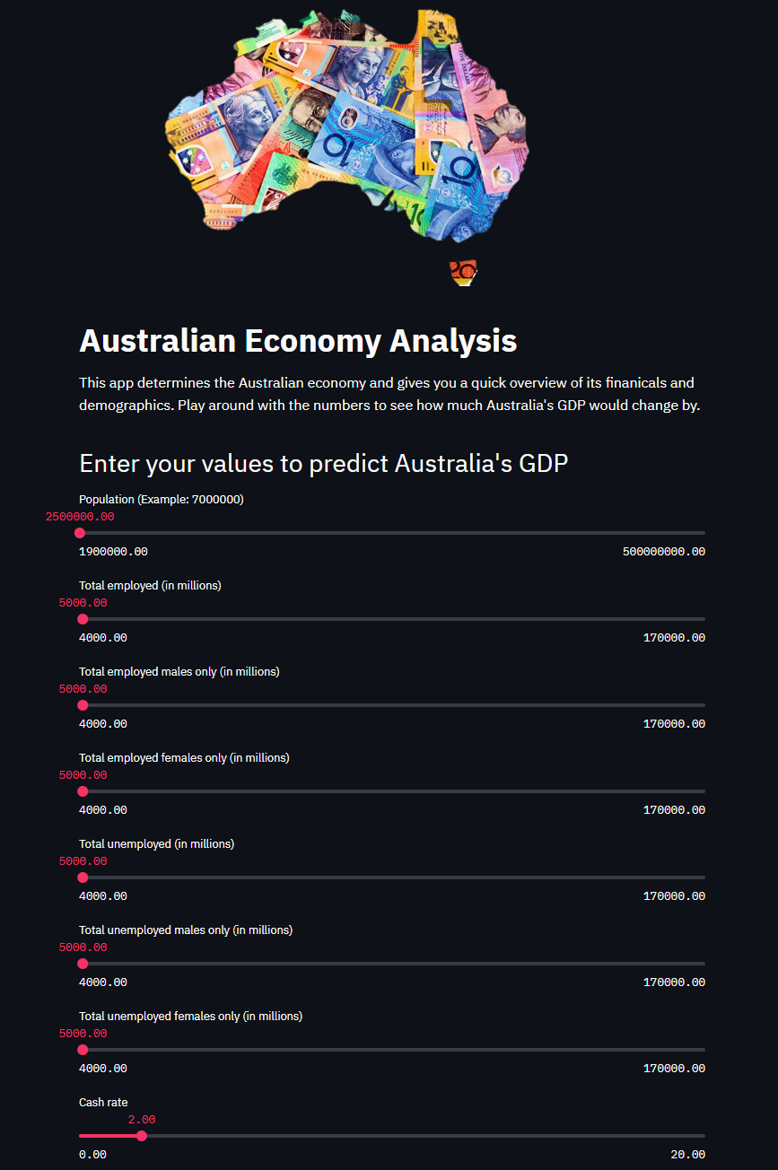
DashBoard & App

Slide 16
Difficulties arose…
Data obtained
GitHub collaboration-Scott
Conflicting issues-Jenny

Slide 17
If we have 2 more weeks…
Discuss any additional questions that arose, which couldn't be answered due to time constraints
-
What would you research next if you had two more weeks?
-

Slide 18




Any Questions…

Slide 19
References
Australia Bureau of Statistics
WorldBank
CuffLinks
Plotly
Machine Learning Classifiers
StreamLit
CoreLogic

